Slide 1
Introduction to Floe

Slide 2
Agenda
Introduction
What Floe can do
How it works
Summary
Pricing

Slide 3

Introduction
Notes:
Here’s a short video to introduce Floe

Slide 4
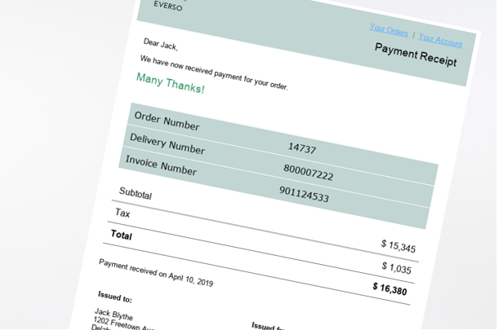
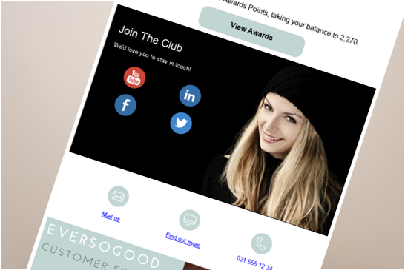
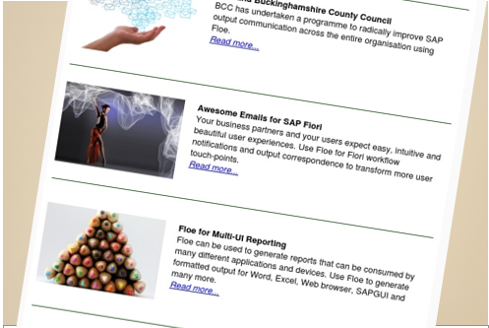
Business Drivers
Email has replaced PDF as the document of record
Your correspondence shapes user and customer experience
Every correspondence should be tailored not just personalised
Notes:
The use of business email is rising: Email has replaced fax and print almost entirely. For many business processes the email is now the document of record rather than an attached PDF.
For most business communities email is the only communication medium. So email design should be an essential part of an organisation’s communication strategy. Automated SAP emails help to shape user and customer experience.
In a world of spam and unnecessary notifications, it is important to maximise the impact of emails. Different email content has different relevance to different recipients, so in order to stand out emails should be tailored for each recipient.

Slide 5
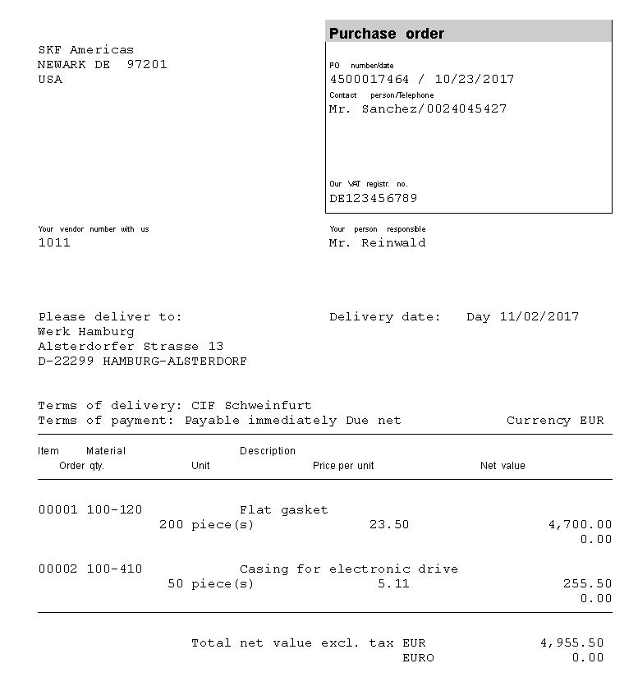
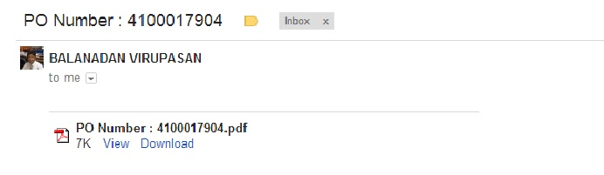
The SAP Email Problem
Email
PDF attachment
Notes:
While many areas of SAP have advanced dramatically email has been left out and we realised it fell short of today’s business needs.
The fact is, HTML email in SAP pretty hard to develop. Moreover SAP standard document output exploits PDF attachments which can be caught up in the corporate firewall. Indeed, speaking as an Adobe partner of many years standing, we can tell you that Adobe’s firewall doesn't let PDFs through. Of course PDF is a superb technology but for many use cases HTML only is a must.
Equally, in reality unless you have SAP CRM there is no recipient management in SAP.
Finally, in those scenarios where SAP does send out an e-mail – for document output or workflow, the resulting e-mails have little or no process data within the content, and often look pretty dismal too.

Slide 6


The Solution: Floe
Email Framework
HTML template management
Dynamic logic for data selection and manipulation
Supports mass communication
Email Generation
Constructs email body based on SAP data and HTML template
Supports nested content
Supports embedded or linked images
Powerful Integration
Simple API to support any scenario
Integrated with SAP authorisations
Integrated with SAP Connect
Notes:
Our Solution is Floe.
Technically it is an ABAP Add-on, the installs on top of your SAP solution.
You can then set-up and use Floe through the normal SAP menus and IMG.
Floe provides a module for email management.
This includes, defining email types, storing the HTML templates, managing all the business logic for data determination, manipulation, attachments, images, recipients etc. – all the components we need to build an email.
And we include the capability to store recipient lists for the purpose of mass communication.
At run-time, Floe is an email generator.
This can be entirely data-driven, so we can dynamically select and manipulate the email template, based on the data from SAP.
We can support very simple emails, or really complex ones, where for example, content is dynamically tailored for the particular recipient, or we have multiple levels of nested content.
Of course we include images, in two different ways, and add in attachments, and create a log so that we can report on exactly what was sent.
Floe provides powerful integration with the SAP data.
And actually, because we deliver it as an API, you can trigger it from non-SAP systems too, passing in whatever data you like.
Floe is integrated to SAP authorisations, so you can control who can do what.
And all the outbound messages flow out of the normal SAP Connect interface, so your Basis team can manage them using the standard tools.

Slide 7
Agenda
Introduction
What Floe can do
How it works
Summary
Pricing

Slide 8
What Floe can do
Notes:
Here’s a short video showing the kind of content we can add to emails with Floe

Slide 9
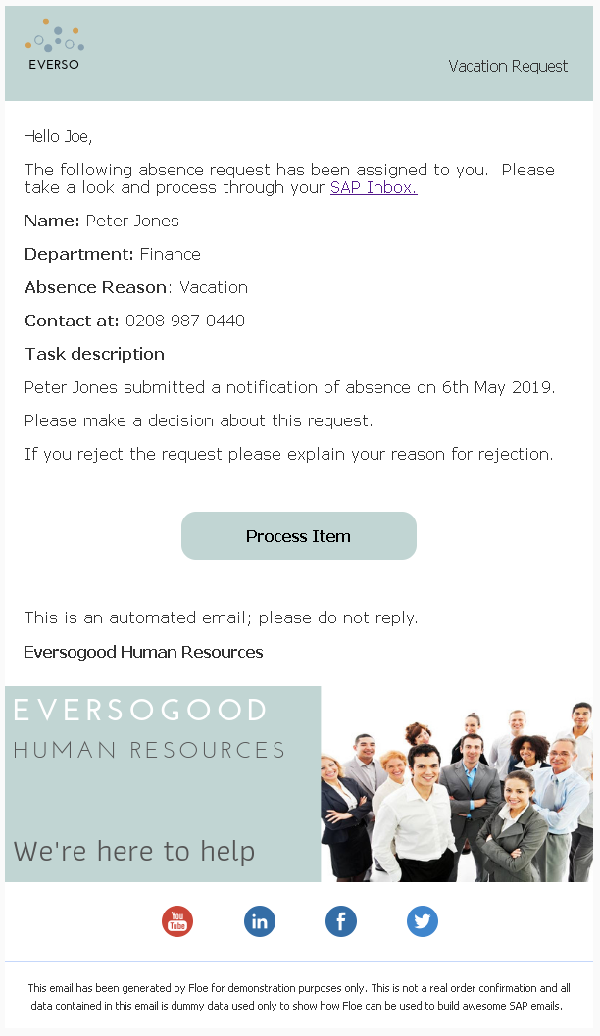
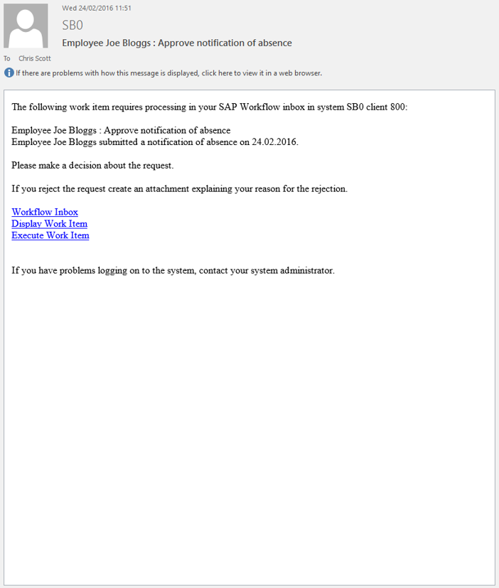

Floe Use Cases
Process Notifications
Transform every SAP Workflow notification
Notes:
One major use case is process notifications.
These can be triggered in various different ways, notably from SAP Workflow.
So instead of plain workflow notifications with no data, you can create impressive notifications with all the information from the workflow container inside the email.

Slide 10
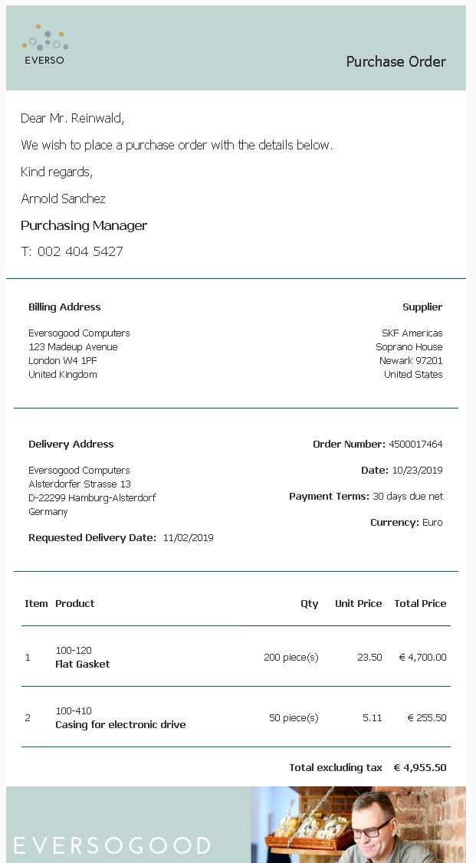

Floe Use Cases
Process Notifications
Document Output
Deliver a new approach for SAP output
Notes:
Floe gives you a new approach for SAP document output.
With Floe you can replace the plain email and the PDF attachment with a new graphical email.
Floe supports dynamic content; so logos can change or information can be included or excluded based on SAP business logic.
So you can replace SAPScripts, Smartforms and Adobe forms with Floe.

Slide 11
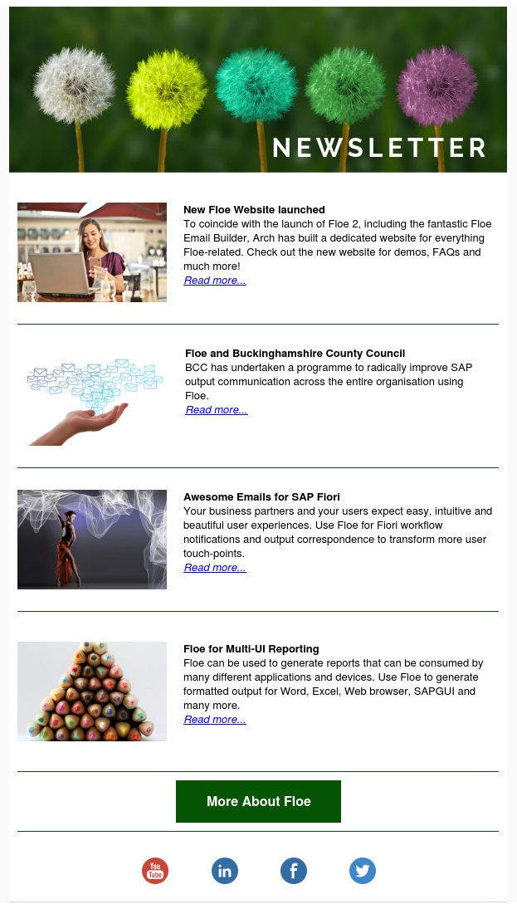

Floe Use Cases
Process Notifications
Document Output
Mass Correspondence
Build tailored emails for all your communities
Notes:
You can also send mass correspondence to different business communities – like partners, contractors or customers.
The emails you send can be tailored to each recipient based on data inside SAP.

Slide 12
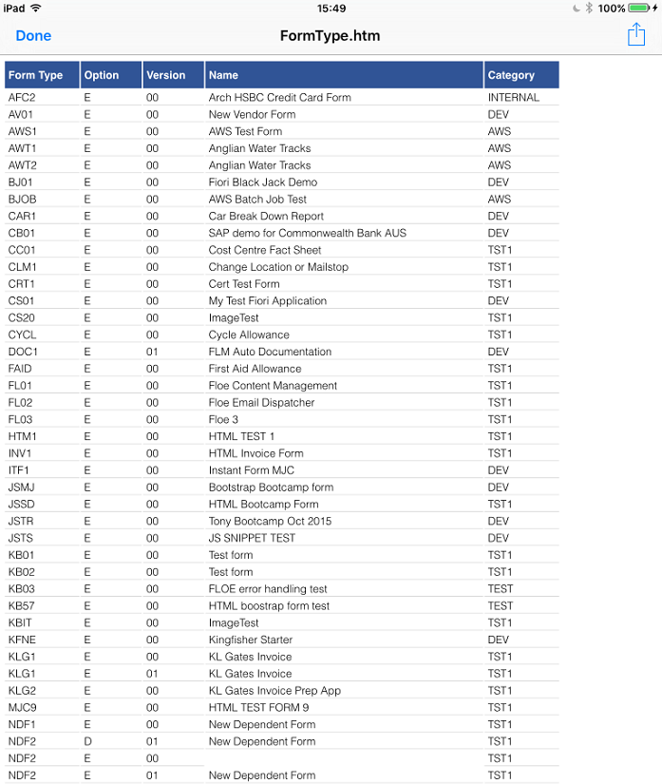

Floe Use Cases
Process Notifications
Document Output
Mass Correspondence
Multi-UI Reporting
Bonus: Pre-formatted reports
Notes:
An additional capability of Floe is the generation of formatted reports that can be consumed using multiple UIs.
Because HTML is a universally-understood language, by creating a Floe output using a simple HTML table, we can create a downloadable report that can be consumed using many different applications and devices.
It’s really great to be able to download information from SAP into, say, Excel or Word, without having to spend a long time re-formatting the raw data.

Slide 13
Agenda
Introduction
What Floe can do
How it works
Summary
Pricing

Slide 14





The Floe API
Workflow
Document Output
Mass Correspondence
Floe API
SAP BCS
SMTP
Notes:
Floe is delivered as an API, and can be triggered from anywhere.
If we consider our use cases, the API is triggered either from a SAP workflow step, or a print program, or from the mass correspondence tool that is included as part of Floe.
In all cases, the Floe API constructs the email and passes it to the SAP Business Communication Service, which in turn routes it to an outbound SMTP Server.

Slide 15
The Floe API
User-Exits
Determine recipients & language
Determine HTML template
Determine data
Construct email body
Determine attachments
Determine images
Notes:
The Floe API collects data, template and other information and constructs the email.
In some cases, we pass in all the data we want to the API.
In some cases we pass in an SAP document number, and then Floe will collect the data it needs.
When we add this kind of business logic, we use the Floe user-exits. This enables us to add our dynamic logic in simple ABAP code blocks.
This means that we have the capability to programmatically over-ride SAP data and the templates, in order to dynamically create tailored emails at run-time.

Slide 16
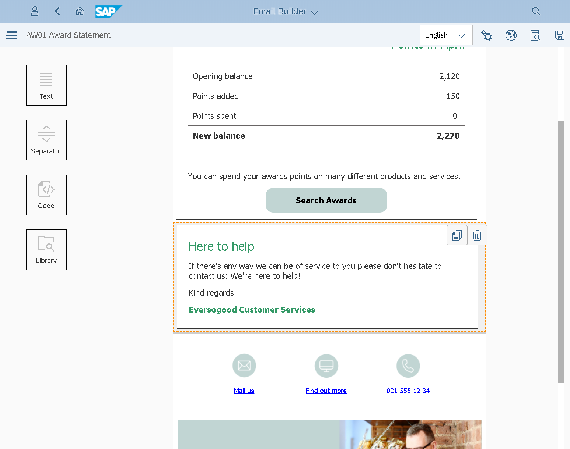
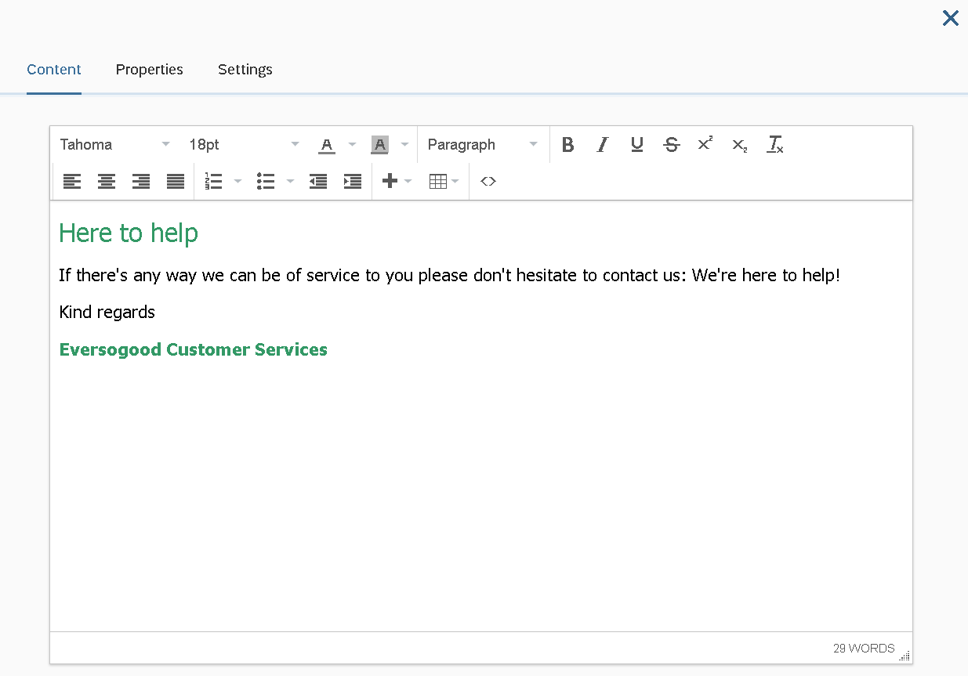
Email Builder
Edit content easily
Drag in content blocks
Notes:
The Floe Email Builder is a business user tool for creating and changing SAP emails.
It’s really easy to use and it enables business users to take control of SAP output for the first time. You can connect the app to your SAP development system, or to your SAP production system, so that changes can be made quickly without involving IT.

Slide 17
Agenda
Introduction
What Floe can do
How it works
Summary
Pricing

Slide 18
Benefits
Small e-mail size
Standard SAP skills
Fast performance
Business users can manage content
Any SAP e-mail
Engaging user experience
No attachments necessary
Low cost
Reduced data storage requirement
Notes:
Here are some of the benefits of Floe.
I wont go through them all, but I think it’s worth highlighting some of the differences between using the email body for document output instead of using a PDF attachment.
Firstly the email size is smaller – a lot smaller. That means that there are benefits down the whole chain – your SAP system, your email server, the recipient’s email server, and the recipient’s email client.
One large customer reckoned that they could make a business case for floe based on the database savings alone.
And of course it’s faster – faster to send, faster to receive, faster to open. And so we’re improving the experience of dealing with us – and that’s part of a digital transformation strategy.

Slide 19

Summary
Exceptional SAP Emails
An experience your customers and employees deserve
Every User Touchpoint
Extend your SAP UX strategy beyond SAP Fiori
Empowered Business Users
Manage email content as master data
Try before you buy
Available on a 60-day trial licence
Notes:
Floe enables you to deliver top-quality email communication - the kind of communication that we all expect these days. It provides a new approach for SAP output.
Floe helps you extend your SAP UX strategy to more user touchpoints – both inside and outside the enterprise. It’s a quick win Digital Transformation product.
Email content can be managed using an easy app by Business Users – directly in the production system if you want, so there’s no waiting for IT and transports when an output changes.
Floe is for every SAP customer, and available on a free trial licence from floe.com

Slide 20
Agenda
Introduction
What Floe can do
How it works
Summary
Pricing

Slide 21
Pricing
 | £ | $ | €
60-day trial | free | free | free
Single installation | 849 / month | 1,249 / month | 995 / month
Enterprise | 4,149 / month | 6,195 / month | 4,950 / month

Slide 22
Questions & Answers

Slide 23
Thank you

